Slide 1
Spring 2012, 18-551
Team 1 : TransOptic
Alex Baran | James Chun | Tom Keagle
alex.v.baran@gmail.com | jtchun@andrew.cmu.edu | tommyk2424@gmail.com

Slide 2
Agenda
Project Idea Overview
Project Model and Signal Flow
OCR Algorithm
Considerations
Research & Findings
Implementation & Optimizations
Data & Results
Challenges Faced
Final Product & Demo
Work Breakdown
References
Q&A

Slide 3
Project Overview
The idea:
Convert image text to ASCII text
Explore different OCR methods
What’s new:
Android functionality
Combines various processes from past 18-551 projects
Adaptable, open for future additions

Slide 4
Proposed Android Application
Android Platform
User Interface and Image Capture
Optical Character Recognition
Displaying of Results and Translation

Slide 5
Android Platform
Cumbersome to iteratively develop on
Loading of android application (apk files) slow
Limited amount of memory
Unable to handle > 3 large bitmaps at a time (for debugging)
Processing speed is slow
~14 seconds initially for pre-processing of images
Incomplete documentation for Java OpenCV functions

Slide 6
Development Workflow
User Interface and Image Capture
Displaying of Results and Translation
Android Platform
OCR Engine
Local Server / Computer

Slide 7
Android Server-Client Model
Enables rapid development
Easier for all team members to contribute
Processing speed is fast
Training, Simulations, Debugging can be done on the computer / server
Modular design enables quick iteration and testing with different OCR components

Slide 8
OCR Algorithm Overview

Slide 9
Pre-Processing / Segmentation
Connected-Component based methods
Morphological Approach
Feature Selection / Extraction
Vertical & Horizontal Projections
Zoning
Dimension Reduction
PCA
LDA
Classification
Naive Bayes, Bayes
Elliptical Fourier Descriptors
Filters (Gabor, Laplacian)
Deep Autoencoder
Nearest Neighbor
SVM
Correlation Filters
LDA
Correlation Filters

Slide 10
Considerations
Memory Efficient
Fast, Minimize computations
Accurate, Invariant to noise (generally robust character recognition)
Modular
Simple to implement

Slide 11
Pre-Processing / Segmentation
Connected Component Based Methods
Morphological Approach
Slow in practice
Susceptible to noise
Faster in practice (< 5s)
More robust to noise

Slide 12
Pre-Processing / Segmentation
Connected-Component based methods
Morphological Approach
Feature Selection / Extraction
Vertical & Horizontal Projections
Zoning
Dimension Reduction
PCA
LDA
Classification
Naive Bayes, Bayes
Elliptical Fourier Descriptors
Filters (Gabor, Laplacian)
Deep Autoencoder
Nearest Neighbor
SVM
Correlation Filters
LDA
Correlation Filters

Slide 13
Dimension Reduction
 | PCA | LDA | Autoencoder
Simple to implement | Yes | Yes | No
Fast | Yes | Yes | -
Modular | Yes | Yes | -
Simple to implement | Yes | Yes | -
Limits to reduction | None, able to adjust to capture variance | At least number of classes – 1 features | -

Slide 14
Pre-Processing / Segmentation
Connected-Component based methods
Morphological Approach
Feature Selection / Extraction
Vertical & Horizontal Projections
Zoning
Dimension Reduction
PCA
LDA
Classification
Naive Bayes, Bayes
Elliptical Fourier Descriptors
Filters (Gabor, Laplacian)
Deep Autoencoder
Nearest Neighbor
SVM
Correlation Filters
LDA
Correlation Filters
MNIST Attributes

Slide 15
MNIST Attributes
Includes various traits of the pixels according to the bounding box
Not as accurate as other attributes
Susceptible to rotation
Simple, first 12 quick to compute, last 4 are slow

Slide 16
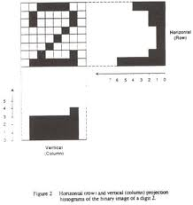
Vertical / Horizontal Projections
Susceptible to illumination
Susceptible to rotation
Simple, quick to compute

Slide 17
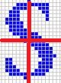
Zoning
Susceptible to illumination
Susceptible to rotation
Simple, quick to compute

Slide 18
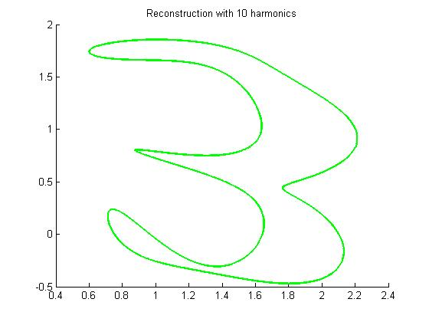
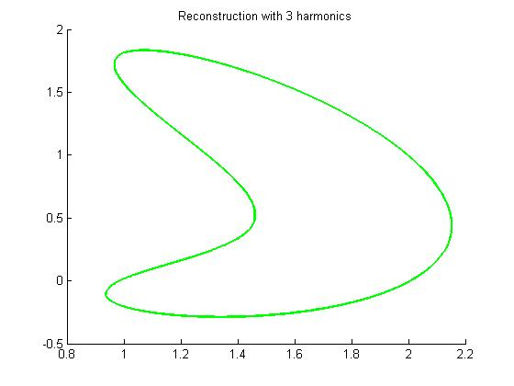
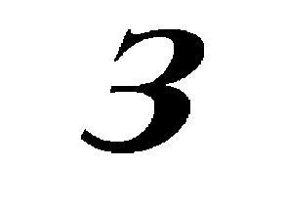
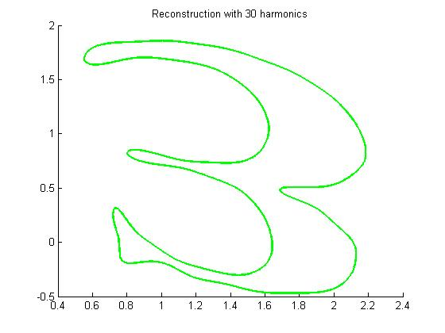
Elliptical Fourier Descriptors
Largely invariant to illumination
Invariant to rotation
Slow to compute

Slide 19
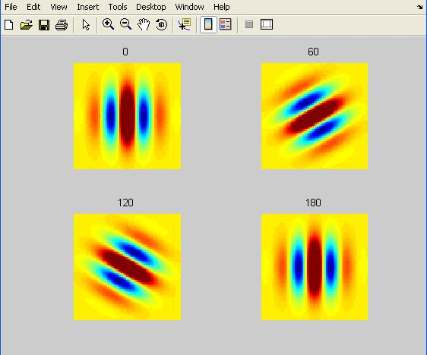
Filters (Gabor, Laplacian)
Combined together give good representation
Large output produced
Slow to compute

Slide 20
Feature Selection / Extraction
 | Projection | Zoning | Elliptical | Filters | Corr Filters
Simple to implement | Yes | Yes | Not really | Yes | Not really
Memory efficient | Depends | Depends | Yes | Not really | Depends
Modular | Yes | Yes | Yes | Yes | Yes
Fast | Yes | Yes | Not really | No | Depends
Illumination Invariance | Low | Low | Yes | Yes | Depends
Rotational Invariance | Low | Low | Yes | Depends | Depends

Slide 21
Pre-Processing / Segmentation
Connected-Component based methods
Morphological Approach
Feature Selection / Extraction
Vertical & Horizontal Projections
Zoning
Dimension Reduction
PCA
LDA
Classification
Naive Bayes, Bayes
Elliptical Fourier Descriptors
Filters (Gabor, Laplacian)
Deep Autoencoder
Nearest Neighbor
SVM
Correlation Filters
LDA
Correlation Filters

Slide 22
Classification
 | LDA | Nearest Neighbor | Bayes | SVM | Corr Filter
Simple to Implement | Yes | Yes | Yes | Depends | Depends
Memory Efficient | Yes | No | Depends | Yes | Yes
Fast | Yes | Depends | Depends | Depends | Yes

Slide 23
Pre-Processing / Segmentation
Connected-Component based methods
Morphological Approach
Feature Selection / Extraction
Vertical & Horizontal Projections
Zoning
Dimension Reduction
PCA
LDA
Classification
Naive Bayes, Bayes
Elliptical Fourier Descriptors
Filters (Gabor, Laplacian)
Deep Autoencoder
Nearest Neighbor
SVM
Correlation Filters
LDA
Correlation Filters

Slide 24
Implementations
SVM
Chose to use features
Proj + Zoning + Elliptical + Filters
Correlation Filters
Simple, ECP-SDF, MACE, OTSDF
Pros/Cons to each
Simple PSR vs Masking

Slide 25
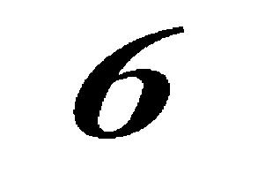

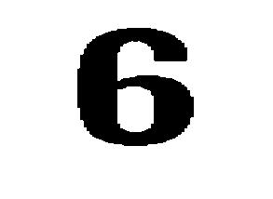
Data: SVM
Used Morphological approach for segmentation
Used PCA for dimension reduction
Number of basis was kept such that variance of at least 99% was captured
Binary Images, Trained on numbers initially (0 – 9)
700 Training Samples
200 Testing Samples
Both datasets varied in font, size and rotation

Slide 26
Research & Findings
Features | SVM Accuracy
Proj + Zoning | 87.6%
Proj + Zoning + Elliptical | 87.65%
Proj + Zoning + Elliptical + Filters | 92.85%
Proj + Zoning + Filters | 96.3%
MNIST Attributes (All 16) | 72.45%

Slide 27
SVM: Future & Summary
Improve feature selection and extraction
Port over to Android platform
Relatively Accurate
Largely invariant to rotation, noise

Slide 28

Correlation Filters
correlation = ifft2(fft2(input).*conj(fft2(filter)));
Pros:
Accurate
Easy to calibrate
Quick training
~10 seconds for 26 characters
Cons:
Rotation variant
Font variant
Require one filter per letter per font

Slide 29
Data: Simple Correlation Filter
Filter (H) = template;
Pros:
Easy to implement
Template vs. test
Relatively accurate
Cons:
Susceptible to noise
Not 100% accurate
Difficult to switch quickly

Slide 30
Data: Simple Correlation Filter

Slide 31
Data: ECP-SDF
H = X*(((X')*X)')*u;
Pros:
Accepts more training
More variable than simple CF
Cons:
Inaccurate
Poor results given complexity

Slide 32
Data: ECP-SDF

Slide 33
Data: MACE
H = D\X*(((X')/D*X)')*u;
Pros:
Very accurate
Good PSR
Barely more complex than ECP-SDF
Cons:
Susceptible to noise
Rotation/font variant

Slide 34
Data: MACE

Slide 35
Data: OTSDF
D’ = α*D + β*I
Pros:
Very accurate
Handles noise
Similar to MACE
Cons:
Font/rotation variant
Not necessary with pre-processing noise elimination

Slide 36
Data: OTSDF

Slide 37
Data: Peak-Sidelobe Ratio (PSR)
Simple version
Compares peak to average
Quick
Relatively accurate
Complex version
Masks peak to calculate average
Negligibly slower
Simple calculations
More accurate

Slide 38
Research & Findings: Accuracy
 | Simple CF | ECP-SDF | MACE | OTSDF
Sans-serif (simple PSR) | 92.3% | 65.4% | 100% | 100%
Serif (simple PSR) | 84.6% | 69.2% | 100% | 100%
Sans-serif (masking) | 92.3% | 73.1% | 100% | 100%
Serif (masking) | 88.5% | 73.1% | 100% | 100%

Slide 39
R & F: PSR
 | Simple CF | ECP-SDF | MACE | OTSDF
PSR max (sans-serif) | 6.08 | 5.38 | 18.7 | 18.0
PSR average (sans-serif) | 2.66 | 2.61 | 4.33 | 4.22
PSR+ max (sans-serif) | 6.99 | 6.01 | 24.4 | 23.7
PSR+ average (sans-serif) | 2.71 | 2.66 | 4.56 | 4.45
PSR max (serif) | 6.15 | 5.32 | 18.7 | 18.0
PSR average (serif) | 2.78 | 2.68 | 4.31 | 4.40
PSR+ max (serif) | 7.04 | 5.93 | 24.1 | 23.2
PSR+ average (serif) | 2.83 | 2.72 | 4.52 | 4.59

Slide 40
Correlation Filters: Future
Test character location potential
Further optimize PSR algorithm
Implement font/rotation variance
Improve noise handling

Slide 41
Correlation Filters: Summary
Good accuracy
Quick and easy to calibrate
Inadaptable to different fonts/rotations
Requires additional filters
Chose to implement OTSDF on Android
Only slightly worse than MACE in testing
Noise handling safer in practice

Slide 42
Translation
Limited Google API documentation
Server connection issues
Time better spent on OCR
Can be implemented in the future

Slide 43
Challenges Faced
Sourcing for quality data
Code conversion from Matlab to Android
Segmentation algorithm consistency
Correlation filter font inflexibility
Translation API difficulties

Slide 44
Final Product
Android Platform
OTSDF Filter
Android Server Client Model
SVM

Slide 45
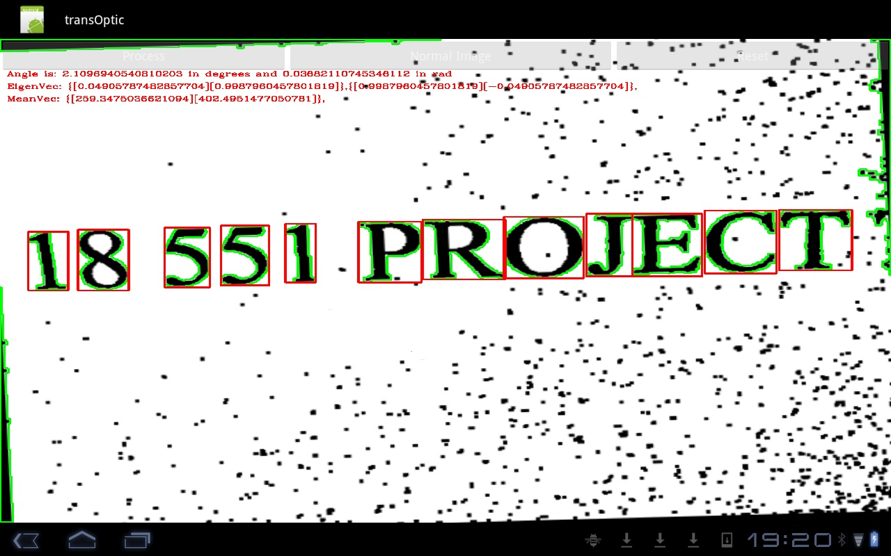
Product Demo

Slide 46
Work Breakdown
Alex Baran | James Chun | Tom Keagle
Generated and Edited Documentation Content | Wrote Android App and Android Client Server Model in Java and C | Researched and Implemented MNIST Features script in Matlab
Implemented and Tested Correlation Filters in Matlab | Researched and tested features for use in SVM in Matlab
Researched Translation API | Implemented and Tested SVM in Matlab
 | Implemented and Tested Segmentation Algorithms

Slide 47
Code References
Used libSVM for multi-class SVM training and testing
Utilized OpenCV Imgproc libraries
Wrote most of the basic algorithms, but used Matlab functions in production
Referred to Casasent, Kumar, and Mahalanobis’ MACE filters paper for correlation filter algorithms

Slide 48
Thank you for support and advice Professor Tom Sullivan Professor Marios Savvides Point TA Yogesh Lab TAs Everyone in CIC 1308 Classmates

Slide 49
Questions?

